Slide 1

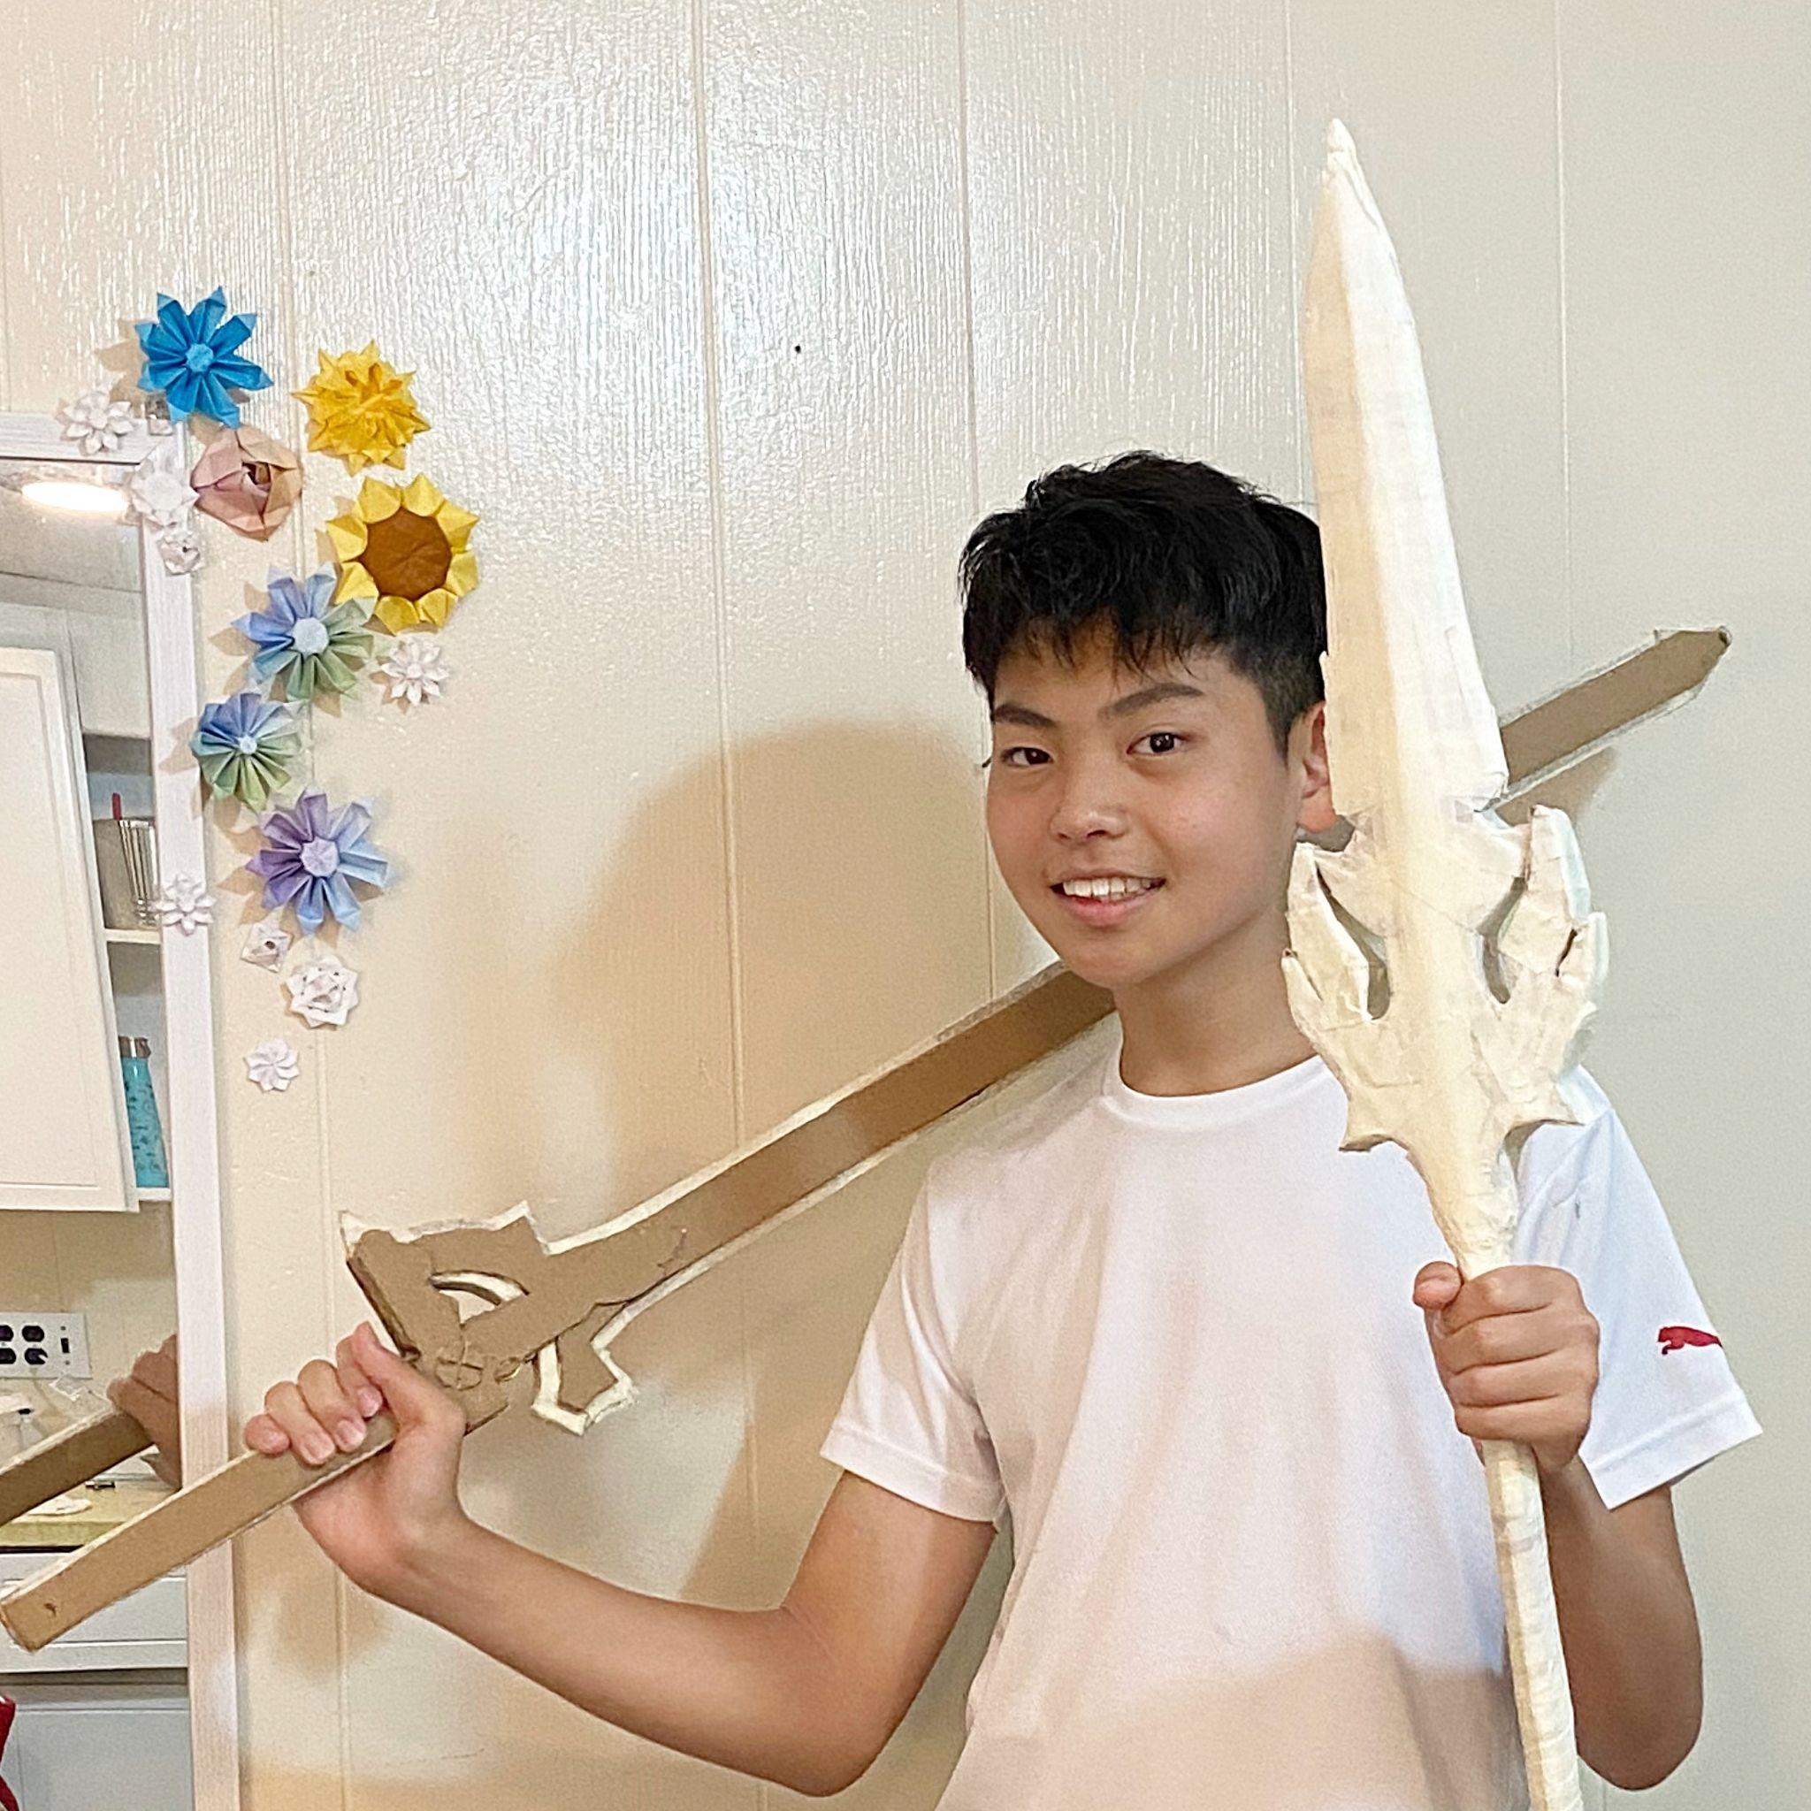



Jimmy in the Box:
Where Paper Crafting Meets Electronics and Coding
Motto: “Craft, code, and play to learn!”
Webb Origami Design Challenge
Boston, MA, USA Team Web Site: https://bit.ly/3D7Tcar Project Web Site: https://github.com/HSSBoston/jimmy-in-the-box

Slide 2
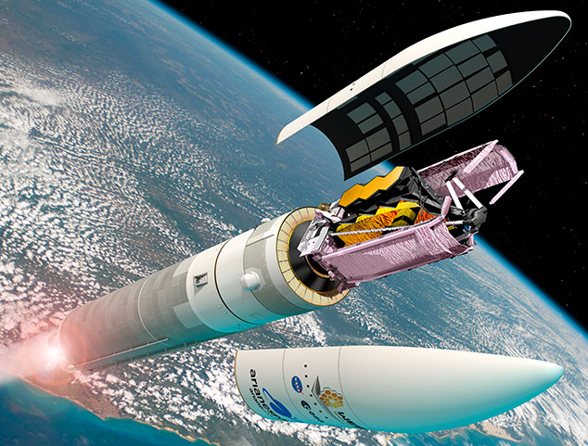
Our Project
Our team members have diverse skills and experience:
Origami crafting
Internet-of-Things (IoT) programming with Raspberry Pi
We all are WOW-ed by how the James Webb Space Telescope (JWST) uses origami-like folding and unfolding.
Our goal: Making computerized origami models for JWST
JWST’s deployment process looked like a Jack-in-the-box for us!
So, we decided to replace “Jack” with “Jimmy” for our project name, respecting Mr. Webb, who supported many science projects at NASA.
Source: https://www.flickr.com/photos/nasawebbtelescope/
Notes:
H

Slide 3
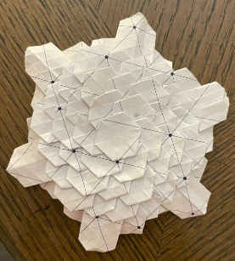
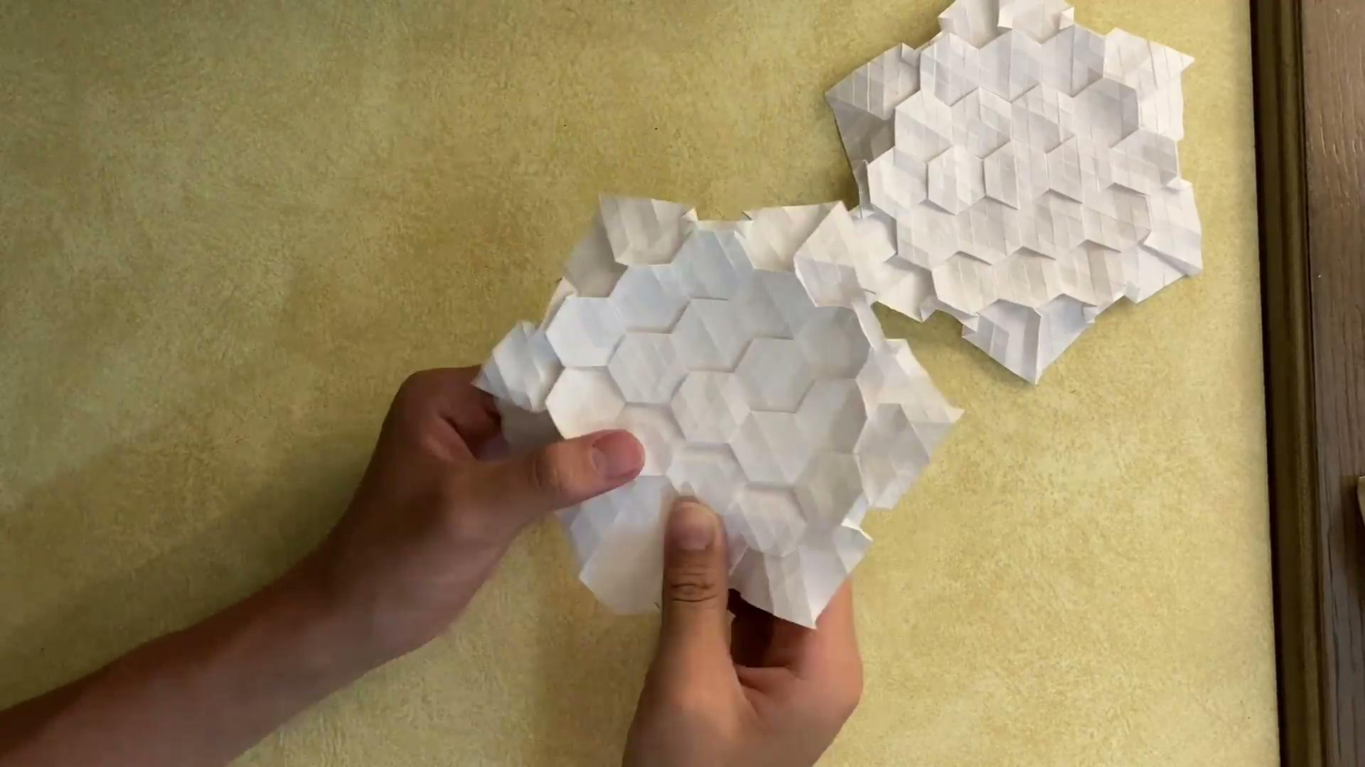
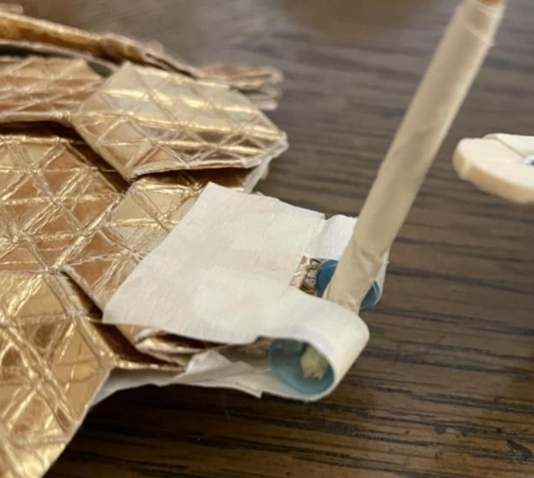
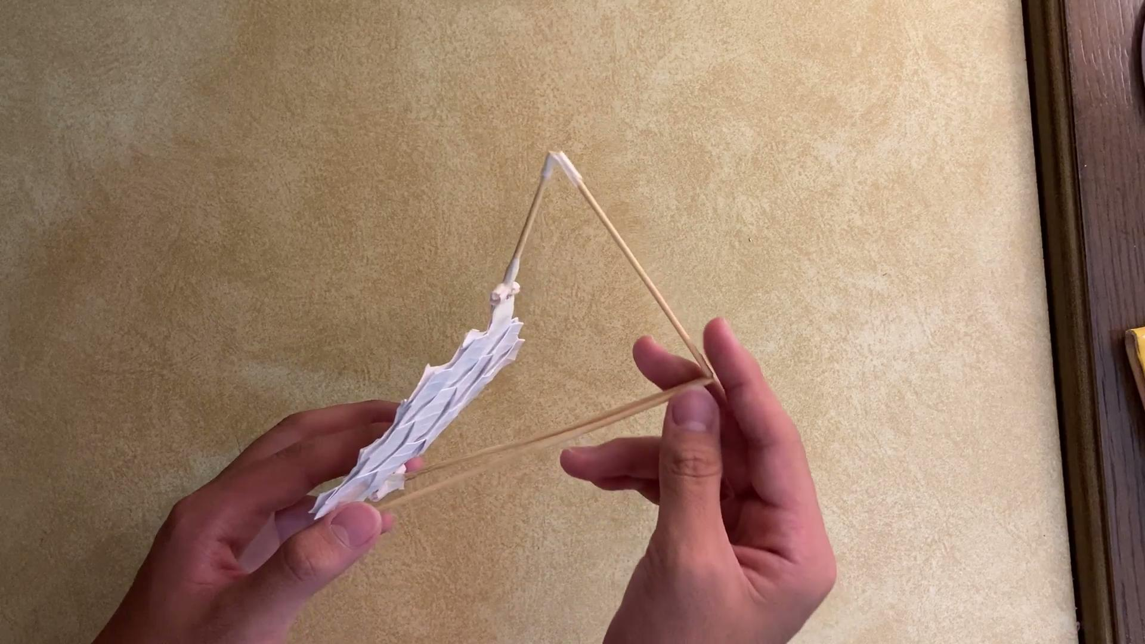
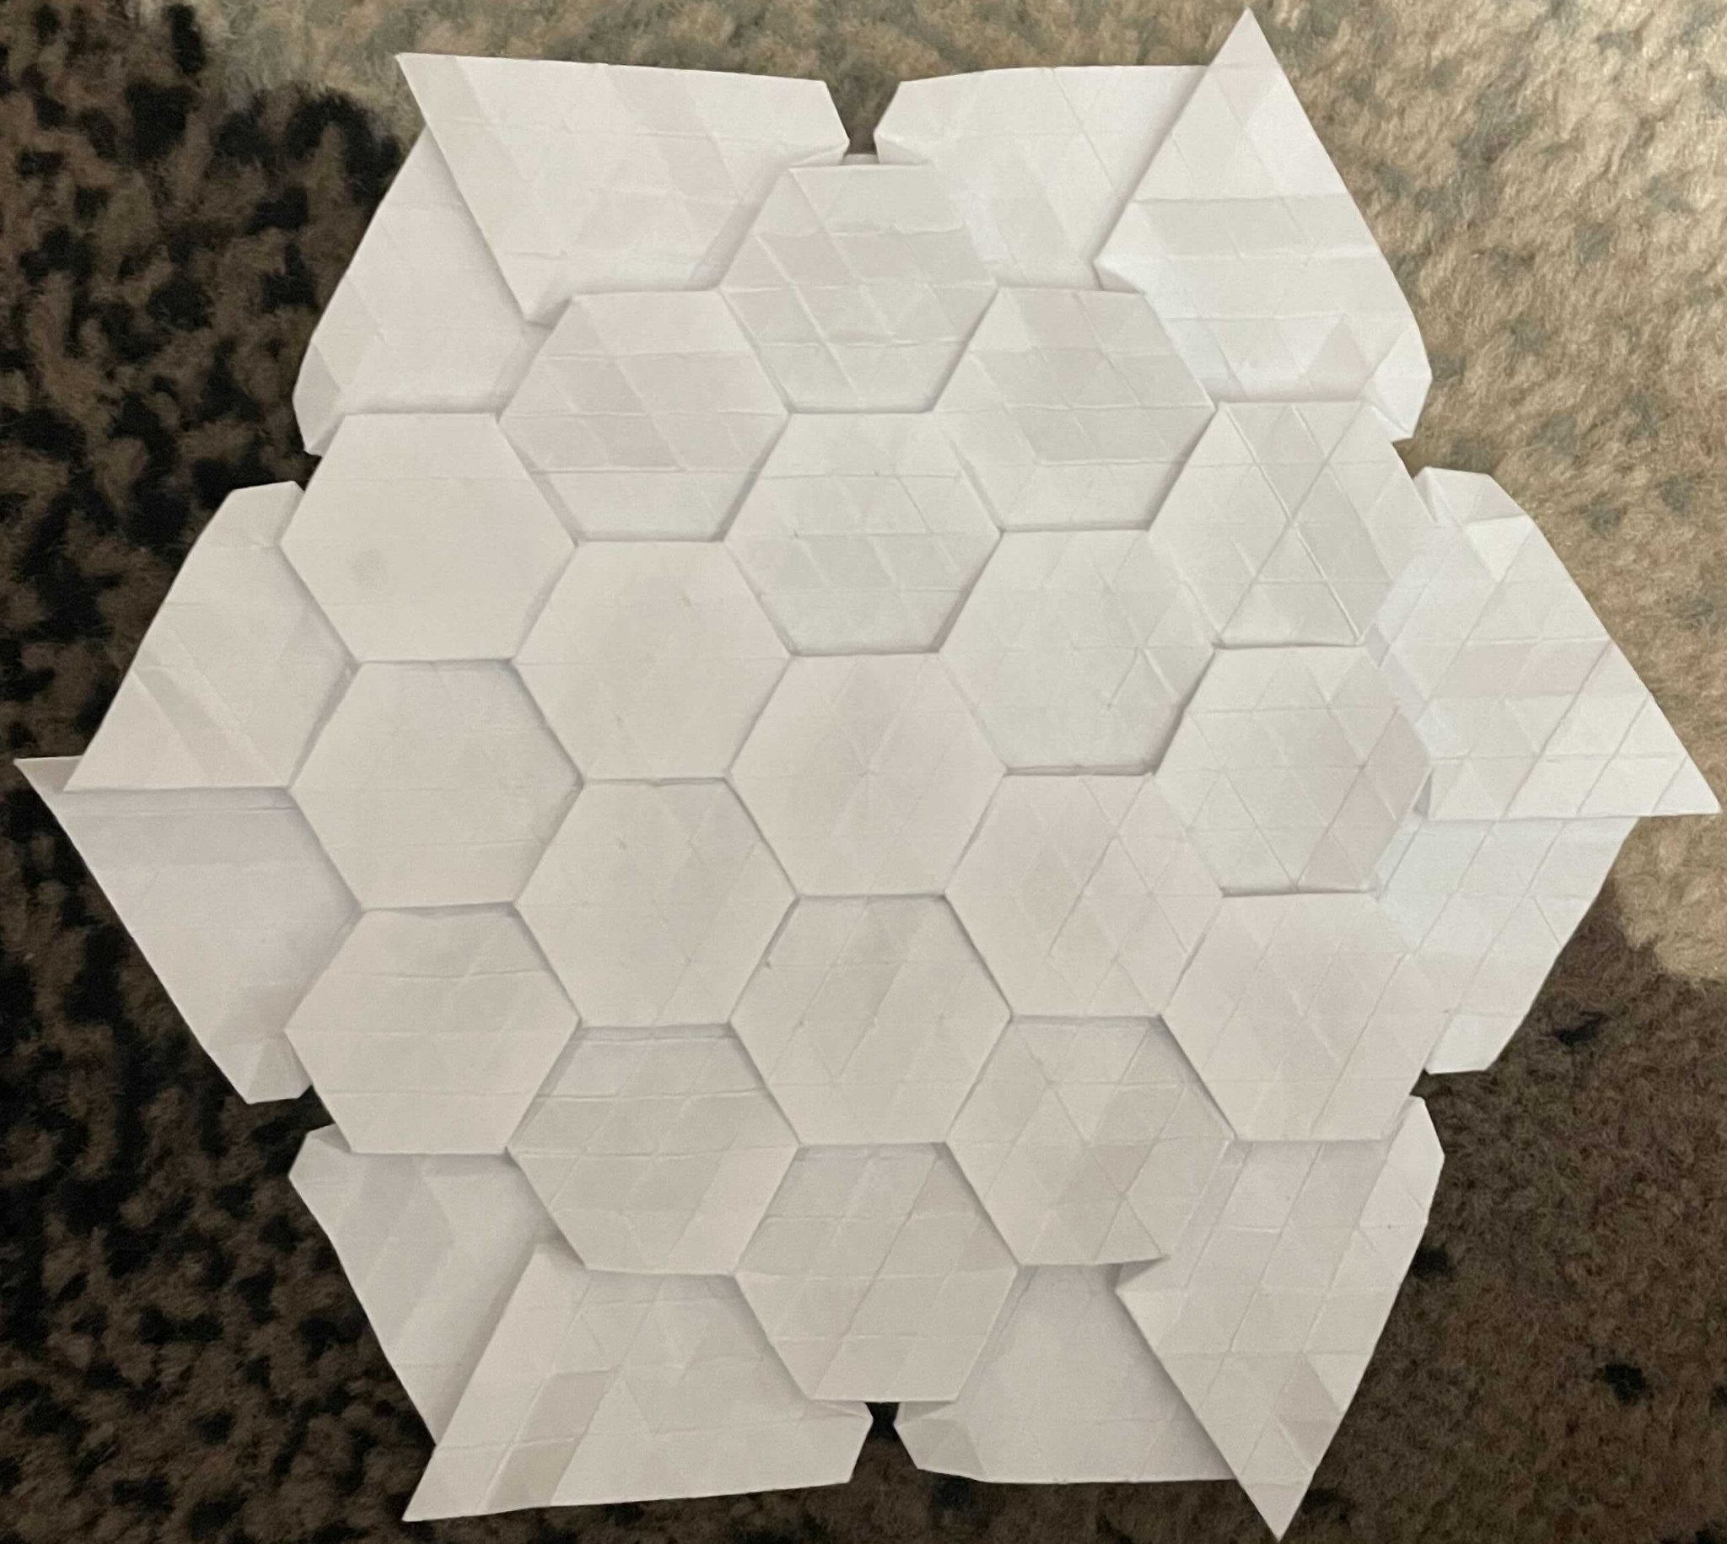
Origami Crafting for Primary & Secondary Mirrors
Customized an existing hexagonal tessellation strategy (by Eric Gjerde) to make our model more similar to JWST’s primary mirror.
Made a hinge-inspired craft to model the secondary mirror’s folding and unfolding mechanisms, w/ a paper tape, plastic straw, glue and bamboo skewer.
Hex tessellation as the primary mirror
Hinge-inspired model for the secondary mirror
Demo Video
Demo Video
TAKESHI’s VIDEO HERE
Notes:
TM

Slide 4
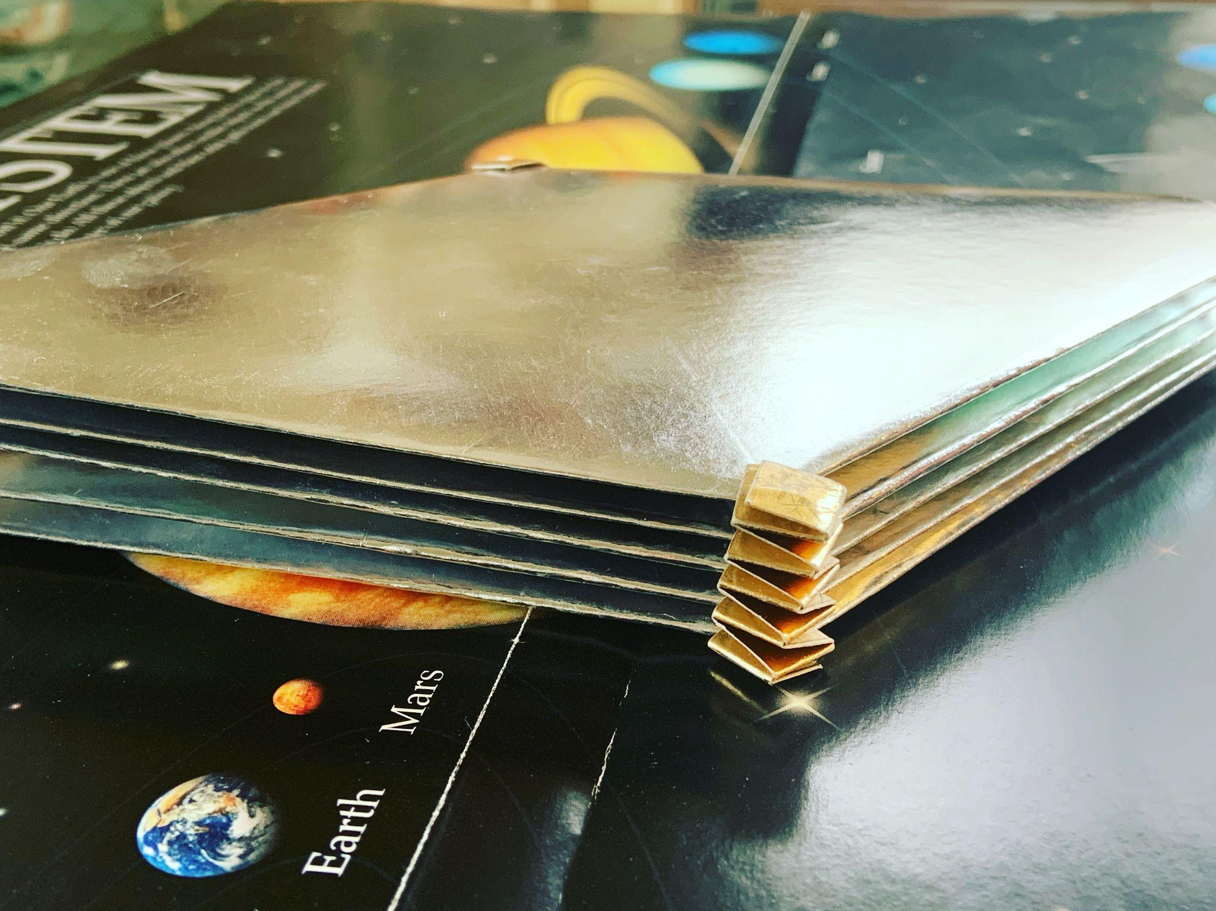
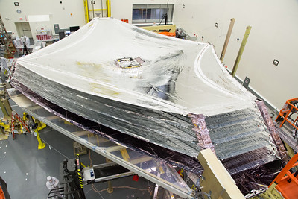
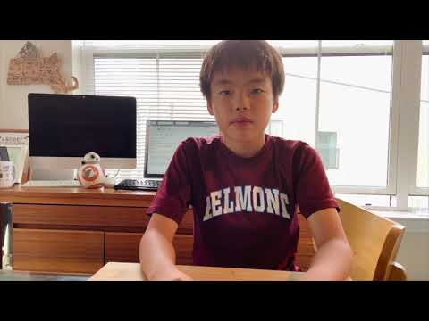
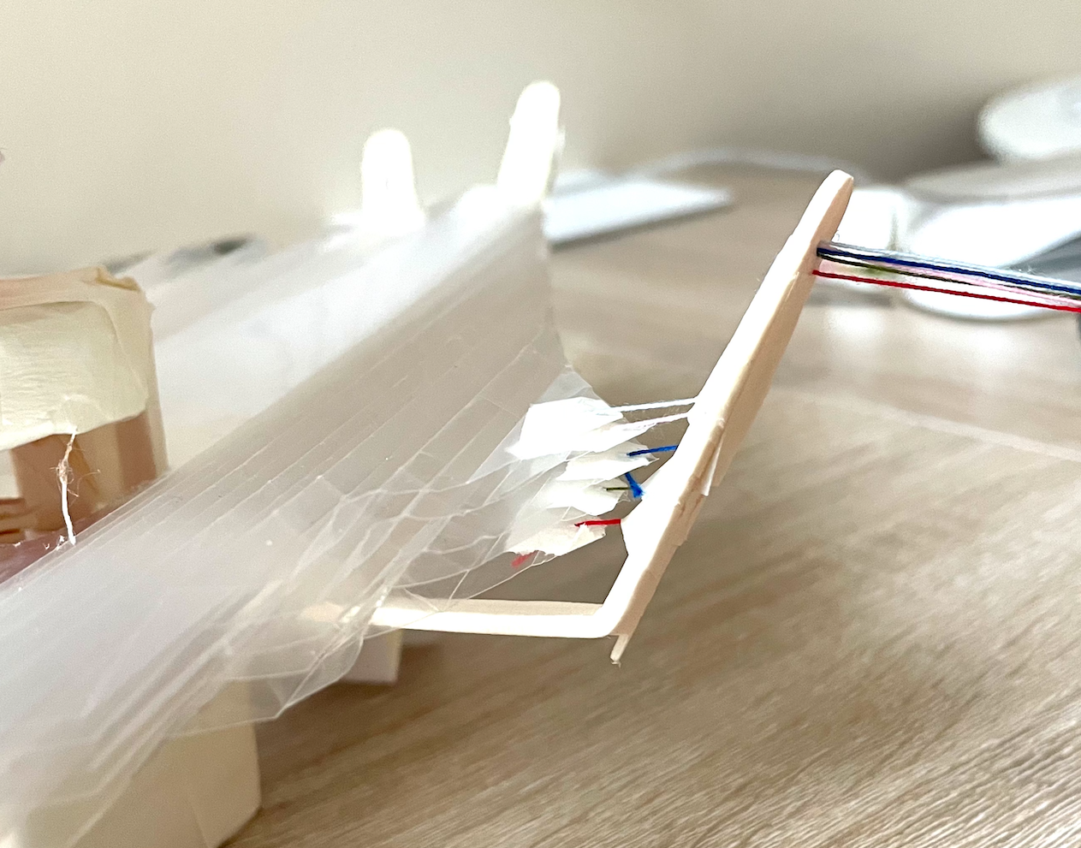
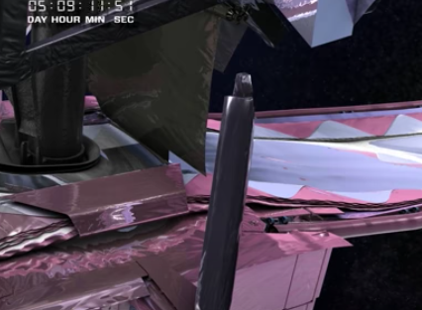
Origami Crafting for Sun Shields
Folded “long” hexagons and stacked them to model JWST’s sun shields.
Used sheet protectors as origami papers and slung five layers of them between foundation bars with strings.
JWST’s Sun Shields
How to make Our Shield
Source: https://www.flickr.com/photos/nasawebbtelescope/
Notes:
Y

Slide 5
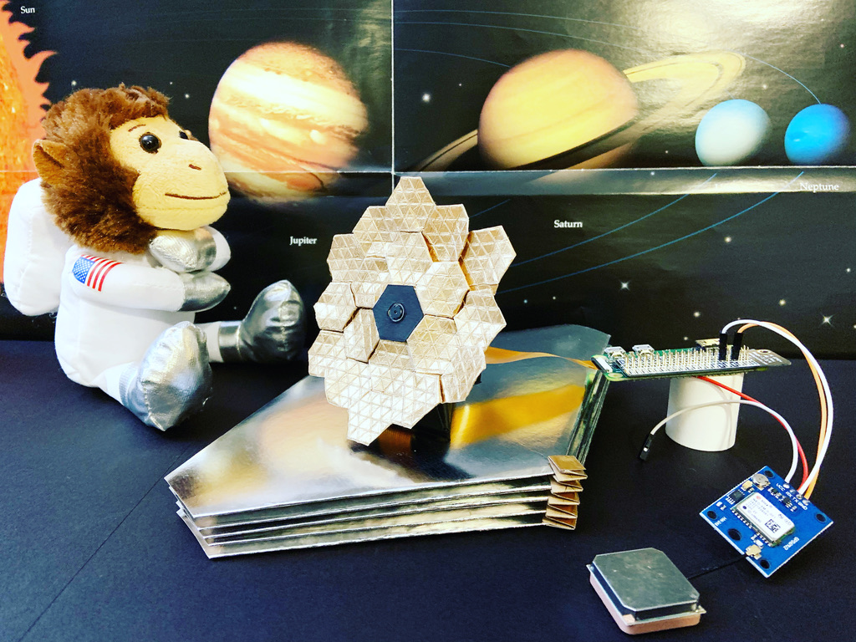
Turning Origami Crafts to Internet-of-Things (IoT) Device
Wanted our telescope models to actively do something, not only being viewed passively.
Integrated a Raspberry Pi (or Raspi; credit card sized computer) with origami crafts, so our model can do what the real telescope does.
Our computerized origami models
Take pictures with cameras and push buttons.
Keep track of the current location (latitude, longitude and elevation) with GPS receivers.
RasPi
Origami Webb Camera
GPS receiver
Notes:
Y

Slide 6



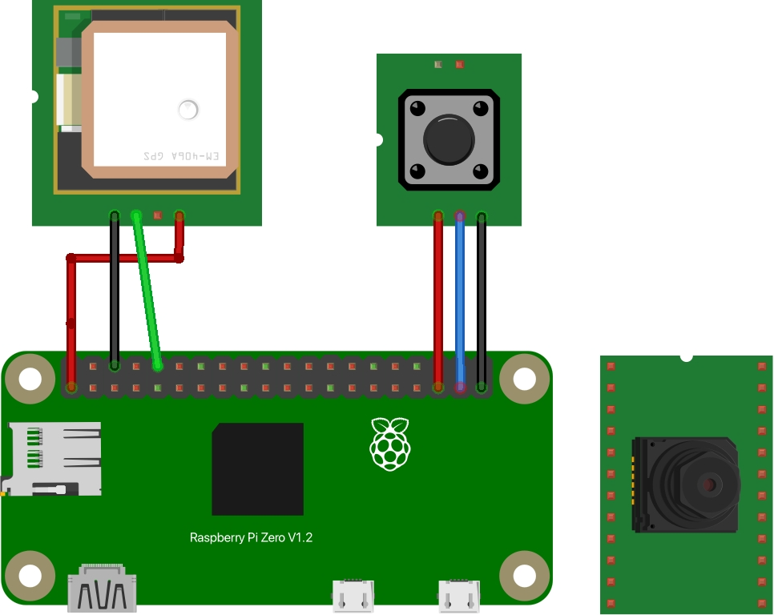



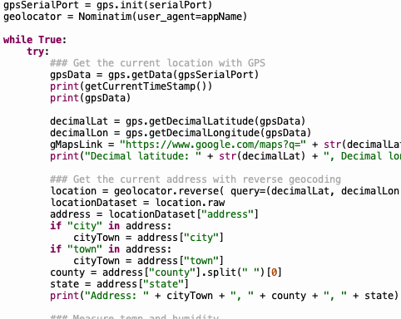
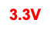
Circuits and Cloud DB App
Python Apps
Periodically takes a picture, gets the current location (latitude, longitude and elevation) and uploads those data to Kintone.
Detects that a push button is pressed, takes a picture and uploads it to Kintone.
Push
button
GPS Receiver
Camera
Raspi
GPIO 19
GPIO 26
Made 3 circuits to wire up a camera, a push button and a GPS receiver.
Set up a cloud database (Kintone) app to store data from a Raspi, convert meters to feet and show a stored location on Google Maps.
Notes:
H

Slide 7
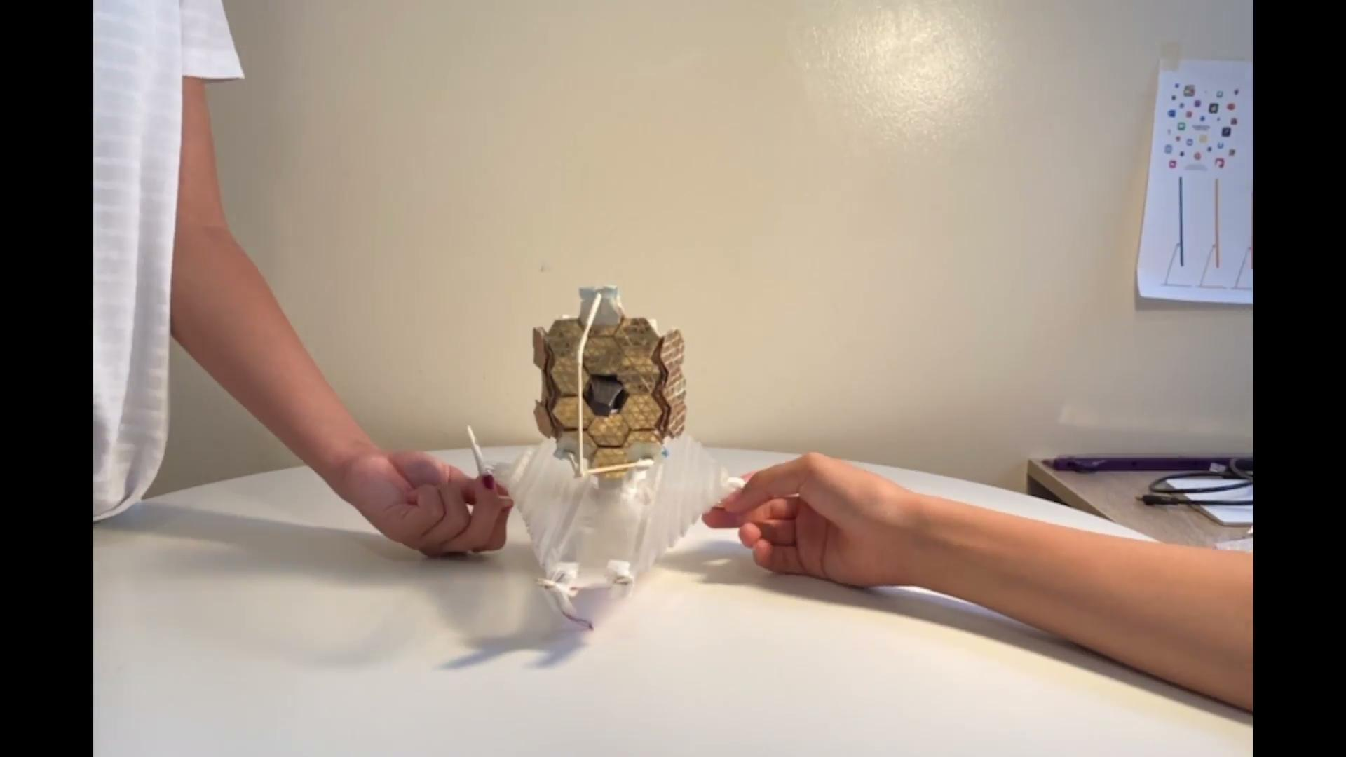
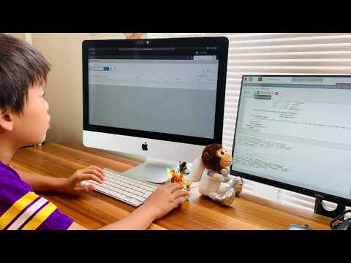
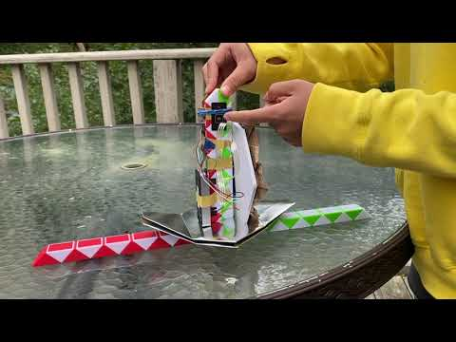
Prototype Models #1, #2 and #3
Future Work
Set up a Web page with videos, diagrams and code to help anyone interested reproduce our origami crafts and IoT telescope models.
Come up with extra tessellation strategies for origami crafting.
Use extra sensors such as gyroscope and magnetometer telescope models
Study how origami techniques can solve other challenges in space; Can we fold and unfold ISS modules, complex satellites or even houses?
Notes:
Y

